Slide 1
Android Development
Android Studio, Activities & Fragments

Slide 2
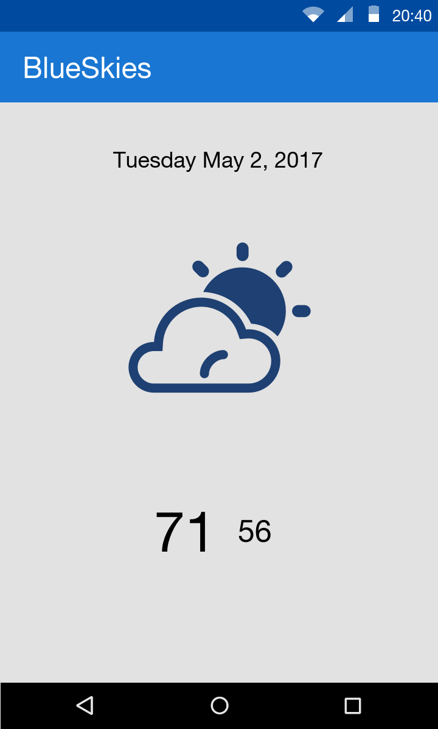
Goals
Develop a BlueSkies App
Activity
Fragment
Layout
Services
Http communication

Slide 3
What is Android
Google mobile SDK
Written in Java
Now supports Kotlin

Slide 4
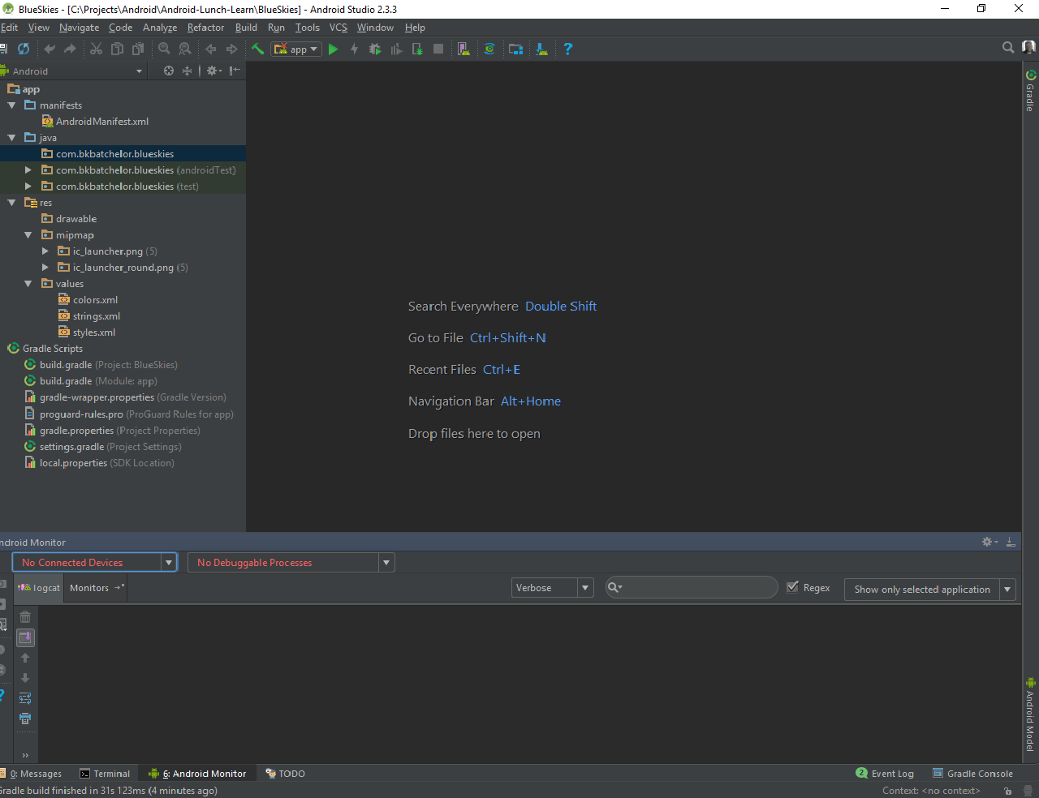
Android Studio
De facto standard for Android development
Built on the IntelliJ
Some features
Layout Editor
Built in emulator
Gradle integration
Instant Run (Hot swap)
https://developer.android.com/studio/index.html

Slide 5
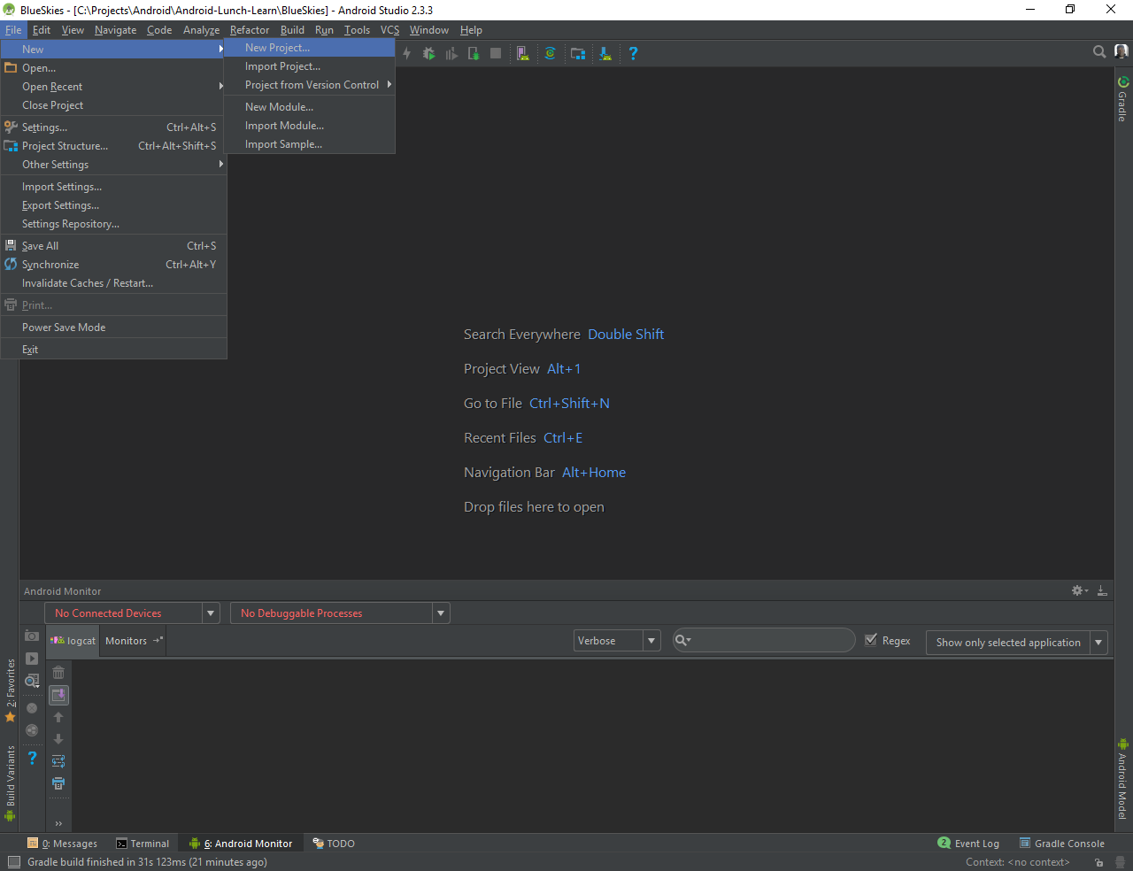
New Project

Slide 6
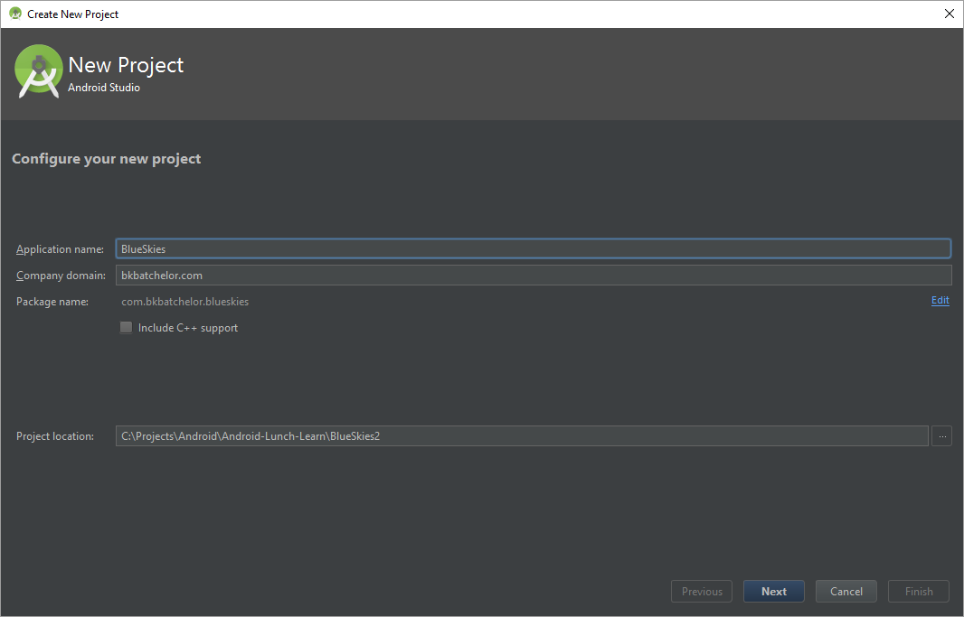
New Project (cont)

Slide 7
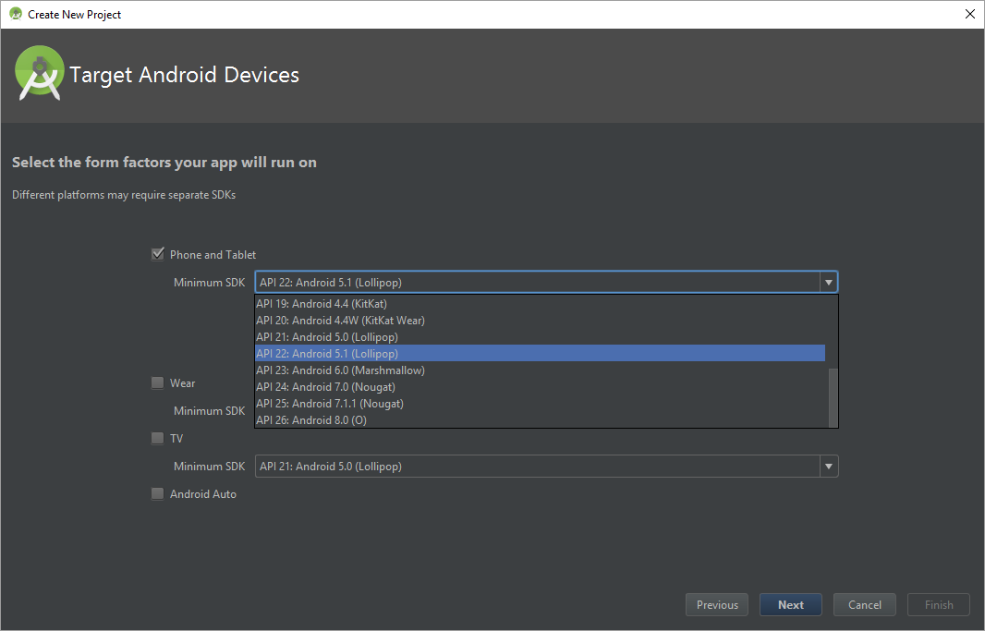
New Project (cont)

Slide 8
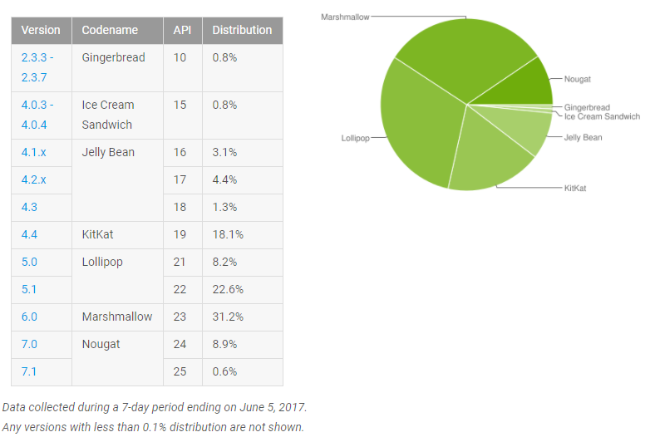
Android Versions
https://developer.android.com/about/dashboards/index.html

Slide 9
Live Example: Android Developer References

Slide 10
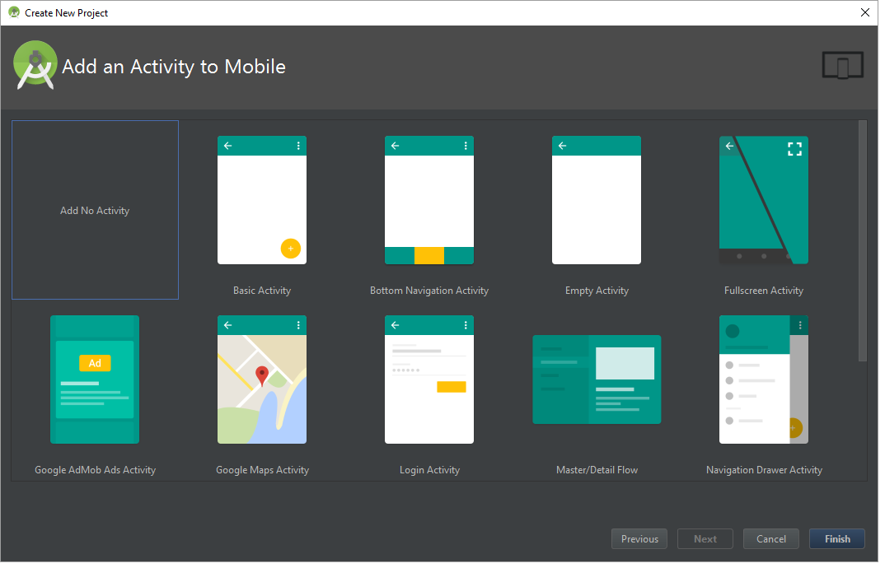
Add Activity

Slide 12
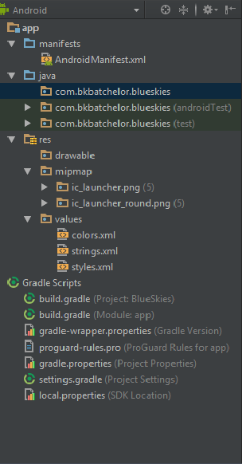

Project Pane

Slide 13
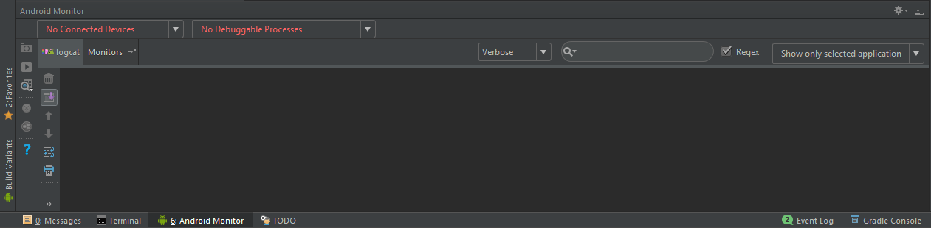
Monitoring and Logcat pane

Slide 14

Run and Debug

Slide 15
Activity

Slide 16

Activity https://developer.android.com/guide/components/activities/index.html
Fundamental building blocks
Entry point for user's interaction
Provides navigates within an app
Communication between other activities
Communication between child fragments
No Creation or Modification of Views

Slide 17
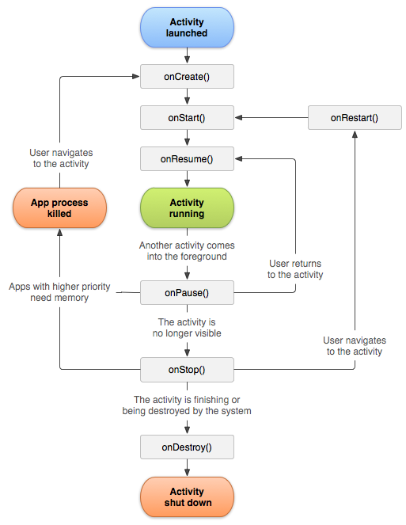
Activity Lifecycle
onCreate() started, but not visible
onStart() visible, but not ready for interaction
onResume() moved to the foreground and ready for interaction
onPause() moving to the background and stopping user interaction
onStop() moved to the background and not visible
onDestroy() moved to the background, not visible and flagged to be destroyed by the system

Slide 18
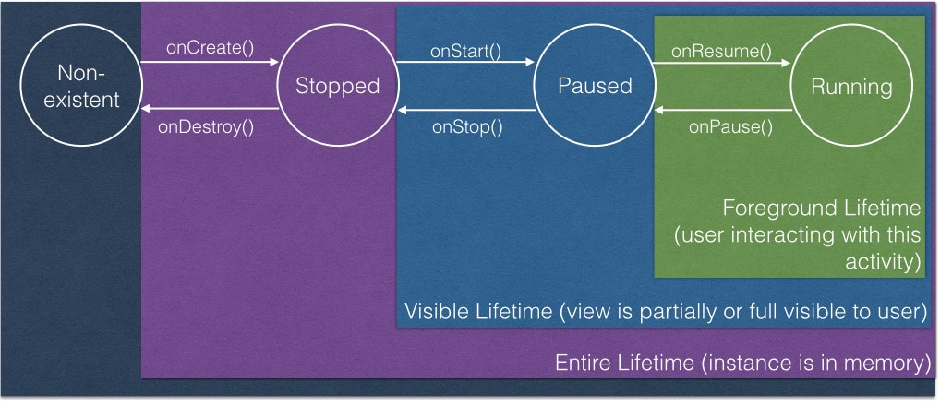
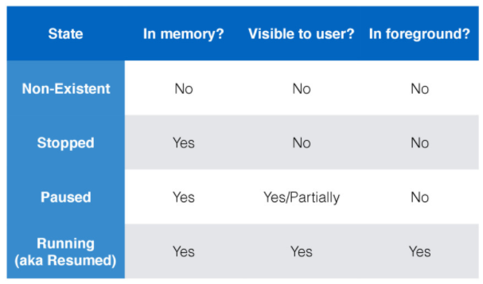
Activity’s States
Kristin Marsicano
https://news.realm.io/news/activities-in-the-wild-exploring-the-activity-lifecycle-android/

Slide 19

Lifecycle relationships
onCreate
onDestroy
Initialize variable
onStart
onStop
Register components (i.e. broadcast receivers)
Unregister components
Set listeners (i.e. click or change)
onResume
onPause
Remove listeners
Save data (i.e. database)

Slide 20
Exploring build.gradle file
Set target SDK version
Set minimum SDK version
Define dependencies

Slide 21
Creating MainActivity
Best Practices
Keep lifecycle methods in order
Place other methods (helpers) below the lifecycle methods

Slide 22
XML Layout
Add XML Layout
XML Layout holds ViewGroups (layouts) and View (widgets)
Best practices
Layout naming convention
MainActivity.java => main_activity.xml

Slide 23
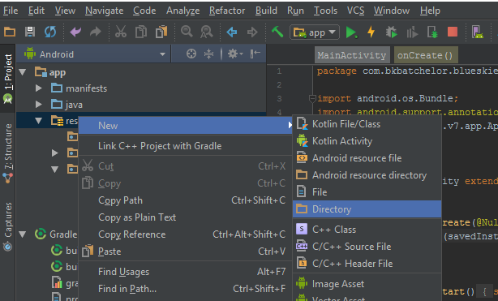
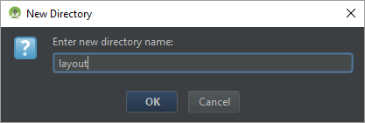
Creating Layout directory

Slide 24
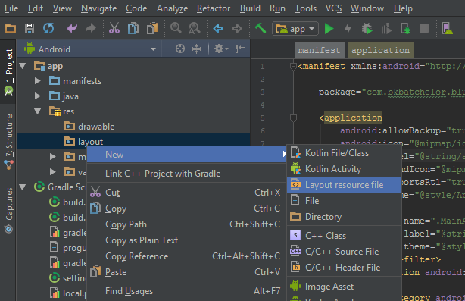
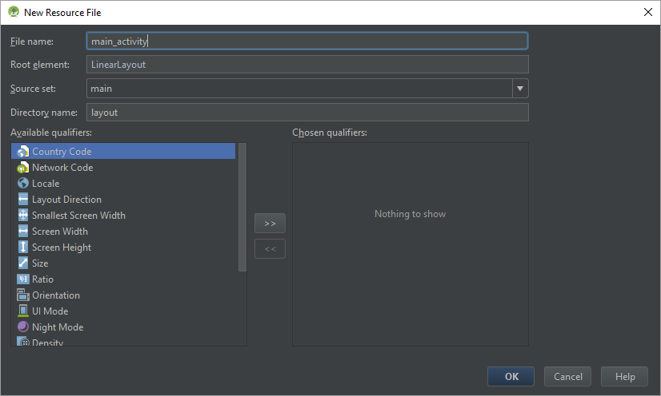
Creating layout XML

Slide 25
Layouts
Types of layouts
Linear
Relative
Frame
Constraint
Best Practices
Attempt to keep the layout flat by avoiding nest layouts

Slide 26
Creating MainActivity
Link Activity to Layout

Slide 27
Editing Android Manifest
Add MainActivity to AndroidManifest.xml
The manifest file provides essential information about your app to the Android system, which the system must have before it can run any of the app's code. (i.e. activities, services, content provider…)

Slide 28
Fragments

Slide 29
Fragment
View and Layout logic
Event handling (i.e. onClick())
Network request
Interacting with a persistence storage

Slide 30
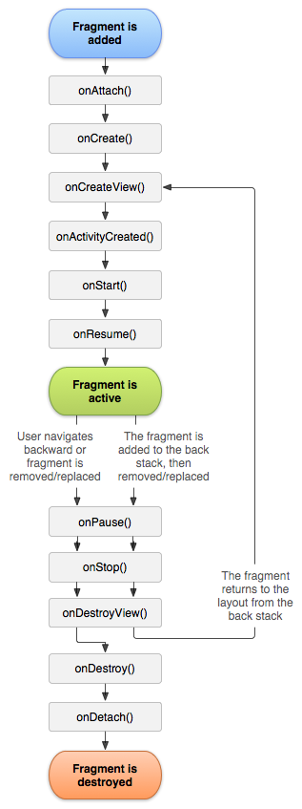
Fragment Lifecycle

Slide 31
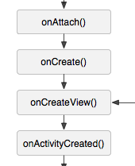
Fragment Lifecycle Create

Slide 32
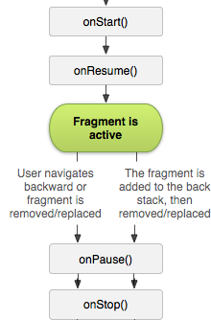
Fragment Lifecycle Create

Slide 33
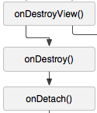
Fragment Lifecycle Destroy

Slide 34
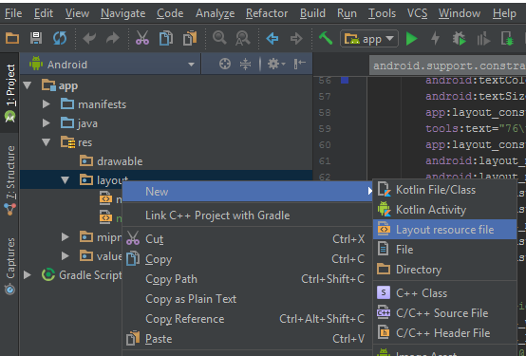

Creating Fragments

Slide 35
Density Independent Pixel (dp)
View Groups and View dimensions
Scale according to screen density, not screen size

Slide 36
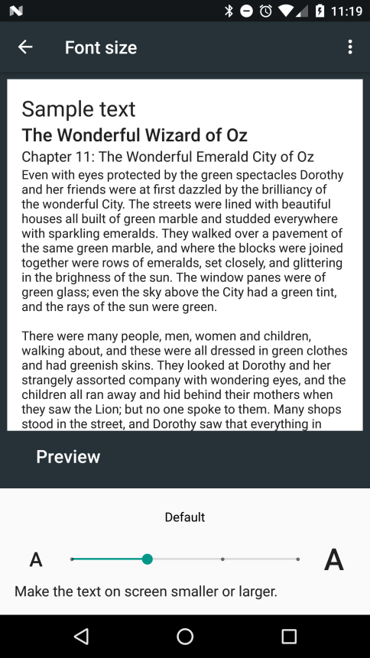
Scale Independent Pixel (sp)
Controlling text size
Scale according to screen density, not screen size
Also, scales according settings font settings

Slide 37
Create Landscape Layout
Live Example

Slide 38
Adding Fragment to Activity
Statically -- add fragment to Activity’s Layout
Dynamically – using Java and Fragment Manager

